Slide 1
Turing College Module 1: Sprint 1: Project
The objective is to use Data Analysis find the optimal hours of sleep for the optimum sleep quality.
The analysis will also reveal the heart rate for optimum sleep quality.

Slide 2
What would qualify as a successful result?
Concrete insight as to: -
What are the optimum hours of sleep per day?
What drives me to get the optimal hours of sleep?
What trends can be observed in my sleep patterns?
What factors influence my sleep patterns?
What factors can optimize my future sleep patterns?

Slide 3
Exploratory Data Analysis (EDA)
For this project, I’ll use the Sleep Data already provided in Module 1: Sprint 1.
For this project, I’ll use Sleep Data columns namely; Sleep Quality, Time in Bed, Wake Up, Sleep Notes, and Heart Rate.
During Exploratory Data Analysis (EDA), an aspect of Sleep Data became clear: Some rows have repeated dates because first I came in for a short nap, woke up to do something then resumed for the long nap.
For purposes of this project, I’ll only consider the long nap as someone can have short naps anywhere like on the subway or in your car after lunch. So this rows will not be part of the project.

Slide 4
Continuation…
I found the Activity (Steps) column irrelevant to my project and therefore removed it entirely.
Since I had the Time in Bed Column already indicating the hours of sleep, the Start and End columns were redundant. I thus removed them from view.
I also changed the order of the columns for convenience purposes.
I boldened and froze the first row for convenience when scrolling through the data.
I applied alternating color scale for easy visibility.

Slide 5
Continuation…
I used conditional formatting on Sleep Quality, Time in Bed, and Heart Rate columns so that it can be easier to view the magnitude just by looking at the data.
There was also Date inconsistencies observed in the data like 2015-01-17 was repeated and thus corrected to 2015-01-16 since this date was missing from the data.
The last row was ambiguous for the start & end did not yield Time in Bed. I therefore removed the row entirely.
Data inconsistency for 2015-01-02 was corrected to 2015-01-04.
Link to Cleaned Sleep Data: https://docs.google.com/spreadsheets/d/1z9NrTtJfcxsS1vvopjFr1_X-nmuCXbxeyPp6Yfq5qhI/edit?usp=sharing

Slide 6
What are my averages?
I used a Pivot Table to calculate my averages for Heart Rate, Sleep Quality, and Time in Bed. They were as follows:
My average Heart Rate was 62.11
My average Sleep Quality was 82%
My average Time in Bed was 7.51 Hours
Later, after complete analysis, I can compare these to the optimum values.

Slide 7
Data Visualizations
For visualization of the data, I used Tableau Public to visualize the Trends & Patterns. Please go through different tabs for different visualizations.
Tableau Public Link: https://public.tableau.com/views/TuringCollegeModule1Sprint1Project/SleepNotesvsHeartRate?:language=en-US&:sid=&:display_count=n&:origin=viz_share_link
The first viz was that of Sleep Time vs Sleep Quality vs Heart Rate. The viz is on the next slide.
It becomes clear that, for the highest (optimum) Sleep Quality & lowest (optimum) Heart Rate, the ideal Time in Bed was 8 Hours.
Here, it can also be noted that for the optimal 8 hours, the average Sleep Quality was 89.13%, & the average Heart Rate was 58.13%.
My average Time in Bed (7.15) is lower than the ideal 8 hours, my average Heart Rate (62.11) is higher than the ideal 58.13%, & my average Sleep Quality (82%) is lower than the ideal 100%.

Slide 8
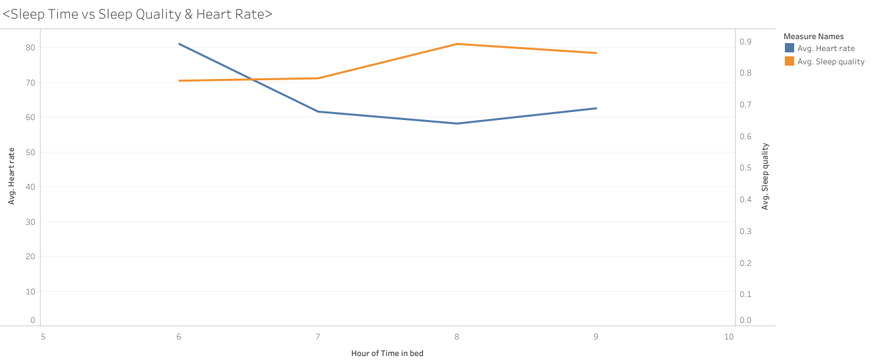
Sleep Time vs Sleep Quality vs Heart Rate

Slide 9
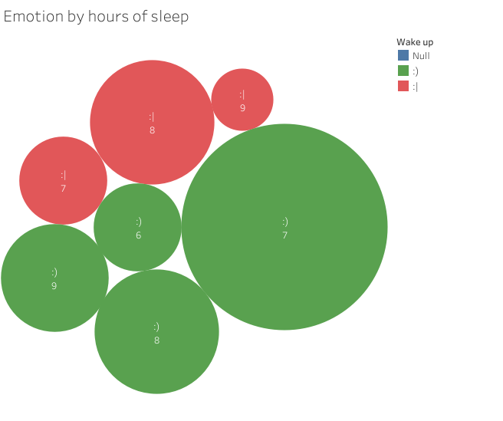
Sleep Time vs Wake Up Emotion

Slide 10
Cont.…
Upon visualizing the wake up time emotions to determine the ideal hours of sleep for the best wake up emotion, I found out:
Ideally, I am happiest after 7 – 8 hours of sleep and,
8 hours gives a neutral average emotion, i.e. neither sad nor happy on average.

Slide 11
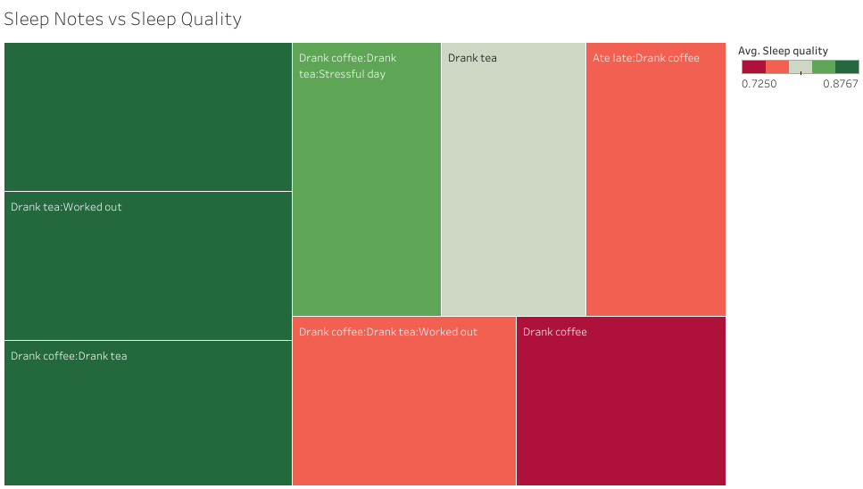
Sleep Notes vs Sleep Quality

Slide 12
Cont.…
For Sleep Notes vs Sleep Quality, I found out that,
Drinking Tea and Working out had the best Sleep Quality and,
Drinking Coffee had the worst Sleep Quality

Slide 13
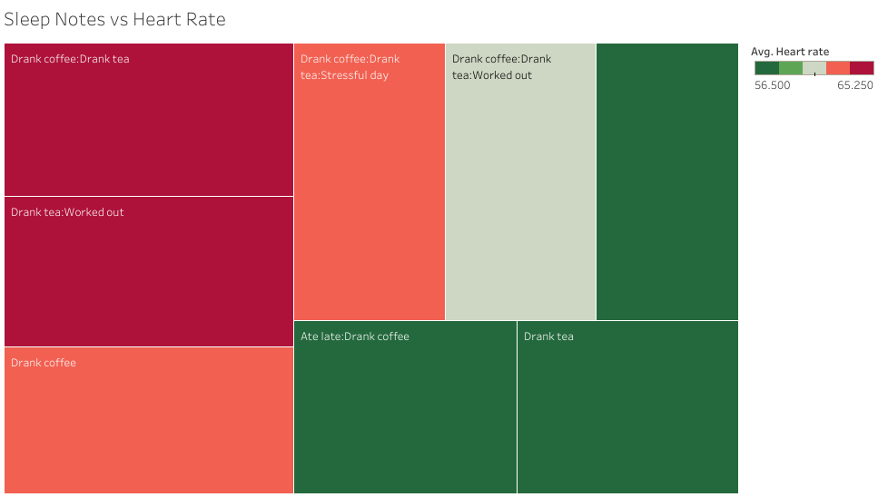
Sleep Notes vs Heart Rate

Slide 14
Cont.…
Here, for Sleep Notes vs Heart Rate, I used a inverted color scheme since a lower heart rate is ideal as compared to a higher heart rate.
I found out that,
Drinking Coffee & Drinking Tea out had the highest heart rate followed by Drinking Tea and Working out. Drinking Coffee was a close third and,
Drinking Tea had the lowest (ideal) Heart Rate.

Slide 15
Conclusions
In conclusion, for the best sleep quality, wake up emotion, and heart rate, I shall endeavor to,
Sleep at least between 7 and 8 hours per day and,
Avoid coffee and working out before bed time as they lower the sleep quality and increase the heart rate and,
Drink tea instead of coffee before bed time. This however is subject to not been accompanied by anything else.

